Slide 1
3.1 Introducing the Derivative
MATH 205

Slide 2
What is a tangent line?
In regards to a circle, a tangent line is a line that intersects the circle at only one point.
In regards to a general curve, a tangent line at a point of a graph is the line whose slope is the limit of the slope of the secant line {as the points move closer together} and passes through the given point, provided the limit exists.

Slide 3
The Difference Quotient
Recall from section 2.1, the average rate of change (slope of the secant line) of a function was given by the formula
This is also known as the Difference Quotient
If we take the limit as h approaches zero, then we can determine the instantaneous rate of change (slope of the tangent line), provided this limit exists.

Slide 4
Rates of Change and the Tangent Line
The average rate of change in f on the interval [a, a + h] is the slope of the corresponding secant line:
The instantaneous rate of change in f at x = a is the slope of the tangent line at (a, f(a)) {provided the limit exists}
Alternate Forms: AROC on [a, x]:
IROC at x = a:

Slide 5
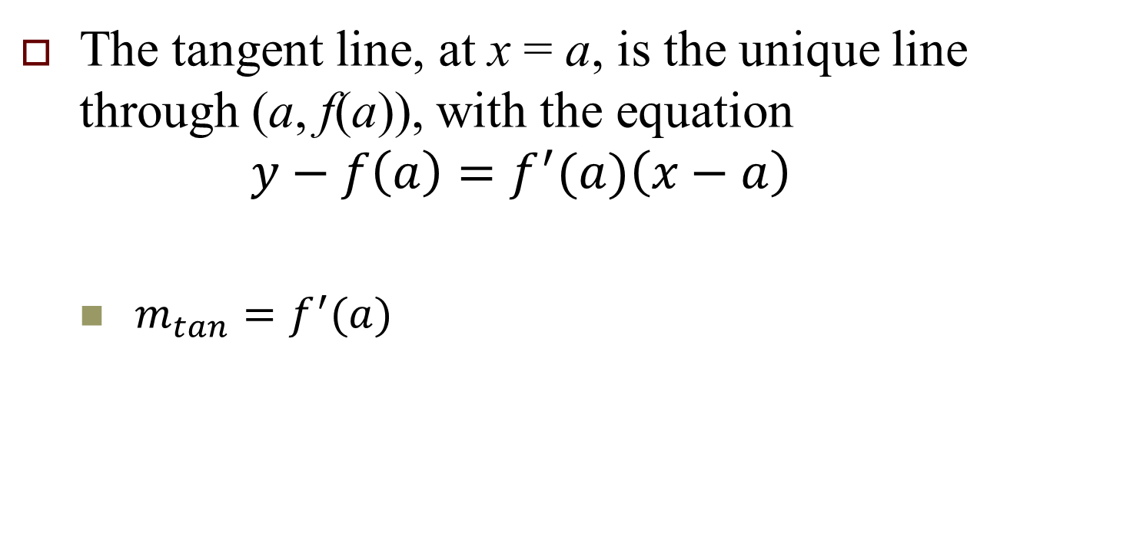
The Tangent Line
The tangent line, at x = a, is the unique line through (a, f(a)), with the equation $y−f\left(a\right)=f^{′}(a)\left(x−a\right)$
${m_{tan}=f}^{′}(a)$

Slide 6
Lets investigate f(x) = x² – 2x + 3
Determine the slope at x = 4.
Determine the equation of the tangent line at x = 4.
Determine the slope at x = a.
Where is the slope equal to 7?
Where is the slope equal to 0?

Slide 7
Lets investigate
Determine the rate of change of g(x) at x = 5.
Determine the equation of the tangent line to g(x) at x = 5.
Determine the rate of change of g(x) at x = a.
Describe the behavior of the slopes of the tangent lines as a increases.
Where does the rate of change equal -1?

Slide 8
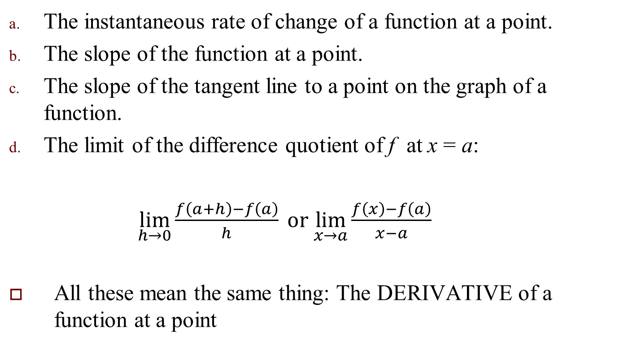
What the heck is a Derivative?
The instantaneous rate of change of a function at a point.
The slope of the function at a point.
The slope of the tangent line to a point on the graph of a function.
The limit of the difference quotient of f at x = a:
$\lim_{h→0}\frac{f\left(a+h\right)−f\left(a\right)}{h}{ or \lim_{x→a}\frac{f\left(x\right)−f\left(a\right)}{x−a}}$
All these mean the same thing: The DERIVATIVE of a function at a point

Slide 9
The Derivative of a function f at x = a
The derivative of a function f(x) at x = a, called is
provided this limit exists.
The limit of the difference quotient is the derivative.
{ is read as “f prime”. This is a variation of Newton’s notation.}

Slide 10
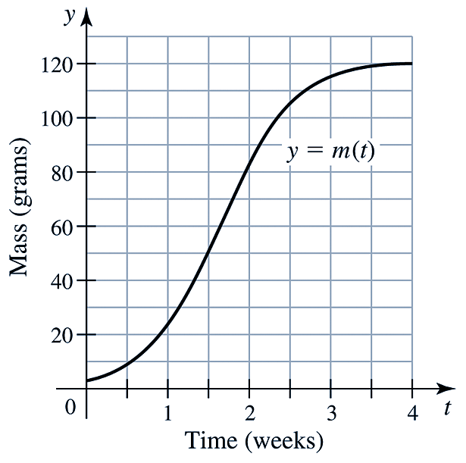
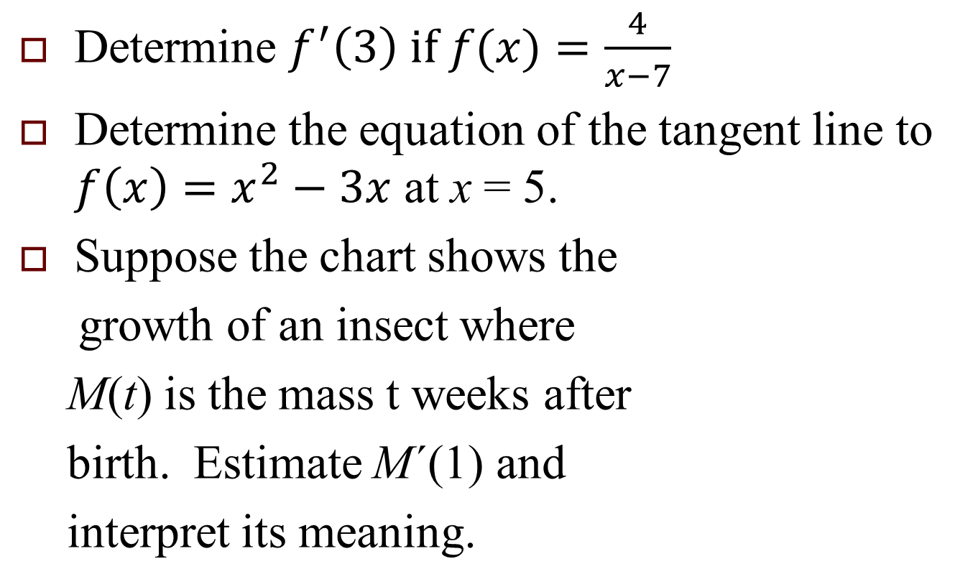
Practice
Determine $f^{′}\left(3\right) if f(x)=\frac{4}{x−7}$
Determine the equation of the tangent line to $f\left(x\right)=x^{2}−3x$ at x = 5.
Suppose the chart shows the
growth of an insect where
M(t) is the mass t weeks after
birth. Estimate M´(1) and
interpret its meaning.

